Slide 1
Tools for Geochemical Analysis Dr. Anoop Ambili

Slide 2
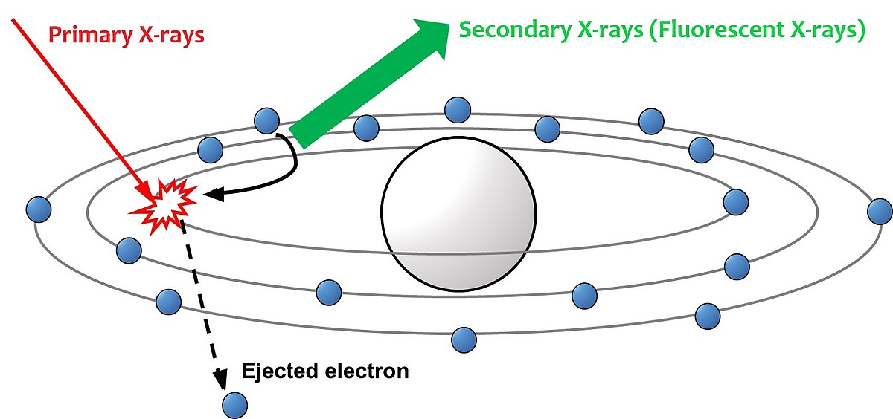
X ray fluorescence technique

Slide 3
Introduction
➢ICP-MS – most widely used techniques for the rapid multi elements quantification at the ultra trace level (ppt range) – at the same time can quantify at the ppm level
➢1983: First commercialized by Perkin Elmer - fastest growing trace element technique
➢Originally developed for trace element quantification in liquid sample – modern instrumentation is capable of analyzing solid sample directly (LA-ICP-MS) – capable of measuring isotope ratio
➢Diverse application fields: Environmental, Geological, Semiconductor, Biomedical, Nuclear Application, drugs and pharmaceuticals etc.
(Lit.: Thomas R. 2013_Chapter 1; Gill, 1997_Chapter 10)

Slide 4
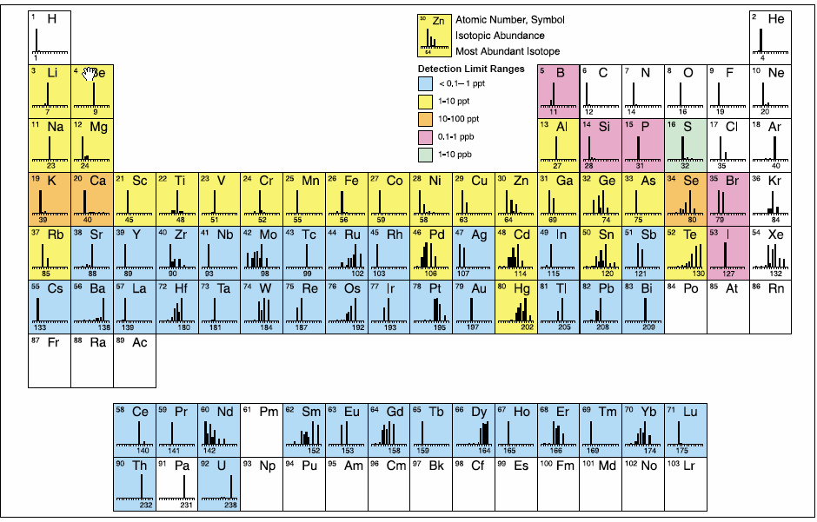
Elements analysed using ICP-MS

Slide 5
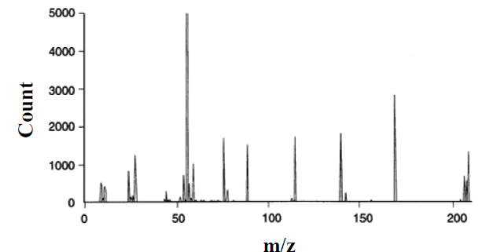
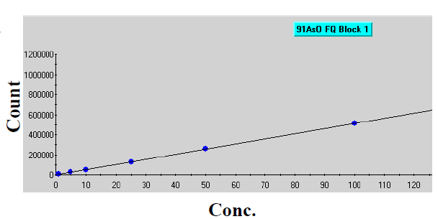
Working Principle
Uses mass spectrometry – separation of ions (coming from plasma source) according to their mass/charge ratio (m/z)
Sample
Source of ionization
Ion selection based on m/z
Detector
Notes:
https://youtu.be/tP5ZKUTWiuQ?si=K1RwNbPQPr2_qFsq

Slide 6
Instrumentation
i) Nebulizer v) Vaccuum chamber
ii) Spray chamber vi) Ion optics
iii) ICP torch vii) Mass separation device
iv) Interface cones viii) Ion detector
(Lit.: Thomas R. 2013_Chapter 1)
Notes:
https://youtu.be/tP5ZKUTWiuQ?si=K1RwNbPQPr2_qFsq

Slide 7
Basic instrument component function

Slide 8
ICP-MS Samples Introduction area

Slide 9
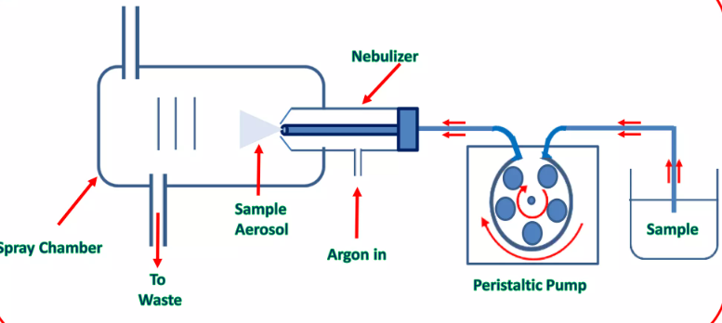
Peristaltic Pump
Ensures constant flow of liquid irrespective of differences in viscosity between samples, standards and blanks. Sample pumped at 1ml/min
Nebulizer
Sample aerosol
Sample
Spray chamber
Sa
Argon in
To waste
Peristatic Pump

Slide 10
Micromist Nebulizer:
Liquid is converted into a fine aerosol by pneumatic action of a flow of argon gas (~1L/min) smashing the liquid into tiny droplets.

Slide 11
Double Pass Spray Chamber:
Spray Chamber only allows small droplets (<10μm) to enter the plasma. Larger droplets having higher momentum collide with wall of spray chamber, get condensed & eventually fall out by gravity through the drain

Slide 12
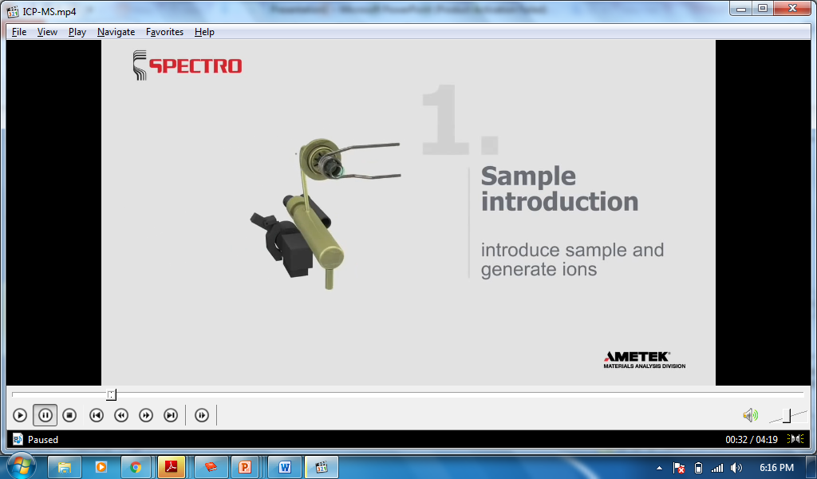
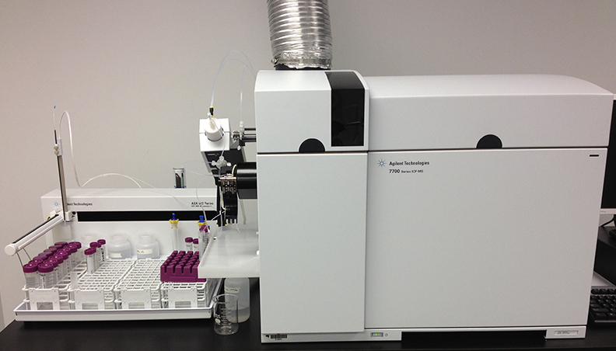
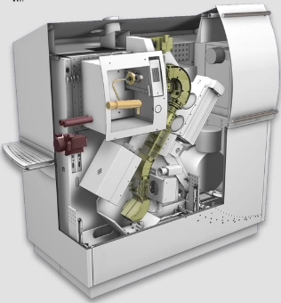
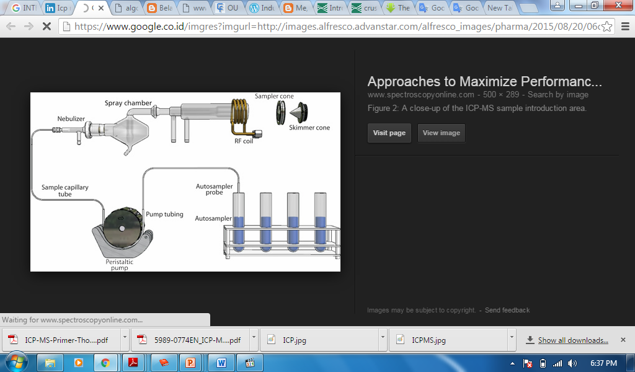

Slide 13
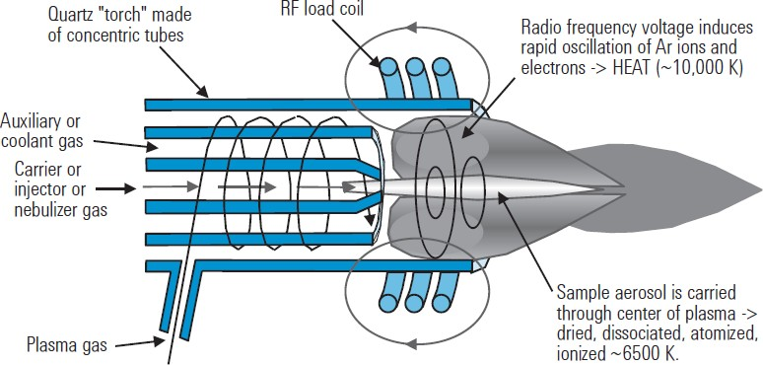

ICP Plasma Ionization Source
Inductively coupled plasmas are formed by coupling energy produced by a RF generator to the plasma support gas with an electromagnetic field. The field is produced by applying an RF power (typically 700-1500 W) to a load coil.

Slide 14
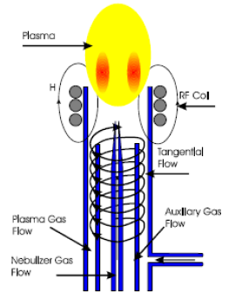
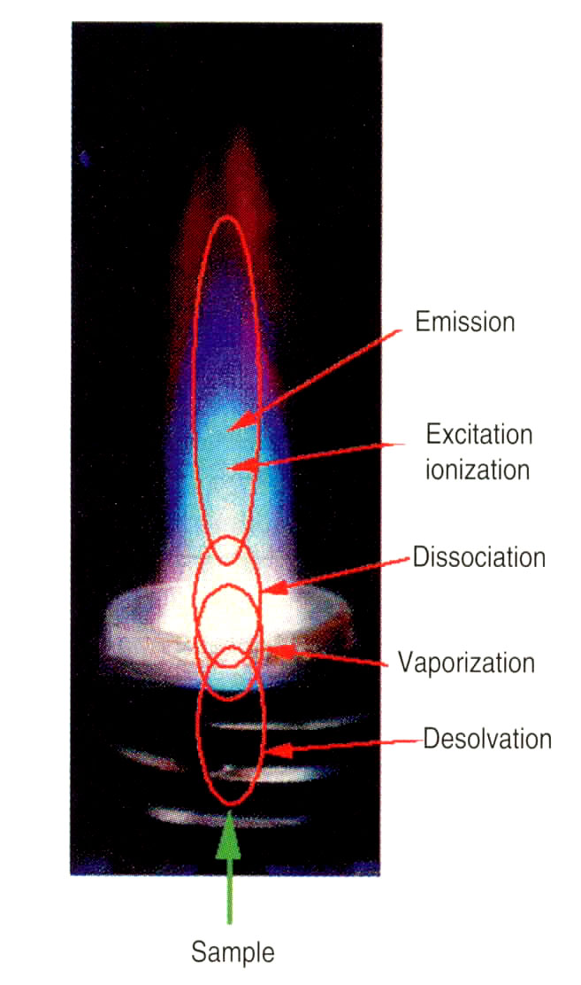
Ionization Process
RF generator is a tool that provides a voltage (700-1500 watts) to ignite the plasma with Argon gas as its source.
This voltage is transferred to the plasma through a load coil, which surrounds the peak of the Torch.
When the sample gas into the plasma occurs excitation of atoms occurs.

Slide 15
Typical ionization for elements
Element | First Ionization Potential (eV) | Ionization Efficiency in ICP | Degree of Ionization
Aluminum (Al) | 5.98 eV | High | >90%
Calcium (Ca) | 6.11 eV | High | >90%
Iron (Fe) | 7.87 eV | High | >90%
Magnesium (Mg) | 7.64 eV | High | >90%
Sodium (Na) | 5.14 eV | Very High | >95%
Copper (Cu) | 7.72 eV | High | >90%
Lead (Pb) | 7.42 eV | High | >90%
Zinc (Zn) | 9.39 eV | High | >80%
Arsenic (As) | 9.79 eV | High | >80%
Bromine (Br) | 11.81 eV | Moderate to High | 50–90%
Mercury (Hg) | 10.44 eV | Moderate | 50–70%
Gold (Au) | 9.22 eV | Moderate | 50–70%
Uranium (U) | 6.1 eV | High | >90%
Platinum (Pt) | 8.96 eV | Moderate | 50–70%
Barium (Ba) | 5.21 eV | High | >90%
Tungsten (W) | 7.98 eV | Moderate | 60–80%
Chlorine (Cl) | 12.97 eV | Moderate | 50–70%
Silver (Ag) | 7.57 eV | High | >90%
Argon first ionization potential ~ 15 eV

Slide 16
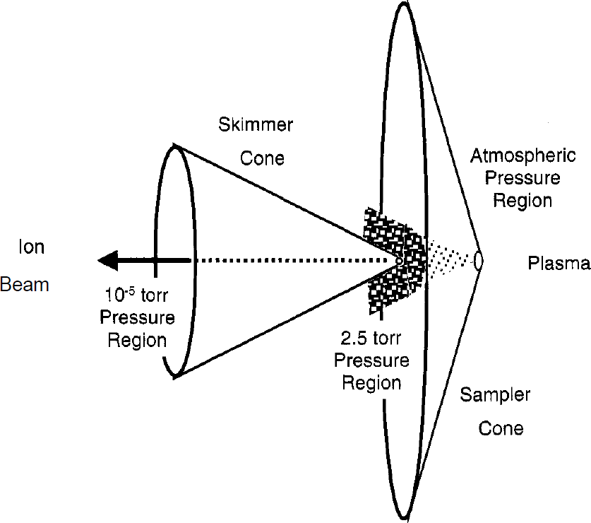
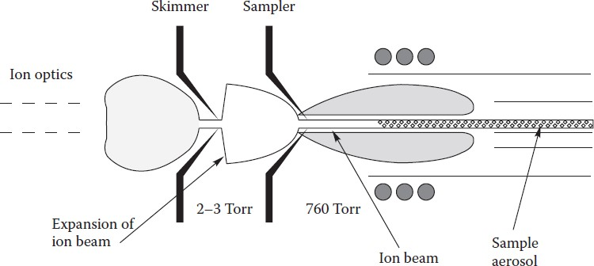
ICP Interface Region
A section that connects the ionizing section at ambient pressure to the mass spectrometer at high vacuum(~10⁻⁶ torr).
Function is to export the ions produced in argon plasma and transport them to the mass spectrometer
Two metallic (Ni or Pt) cones with small orifices (1mm)- Sampler and Skimmer Cones directs the expanded gas jet of ions into the MS

Slide 17
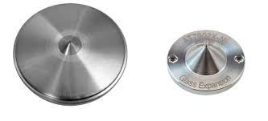
Interface
Sampling Cone (1mm dia)
Skimmer Cone (0.45 mm dia)

Slide 18
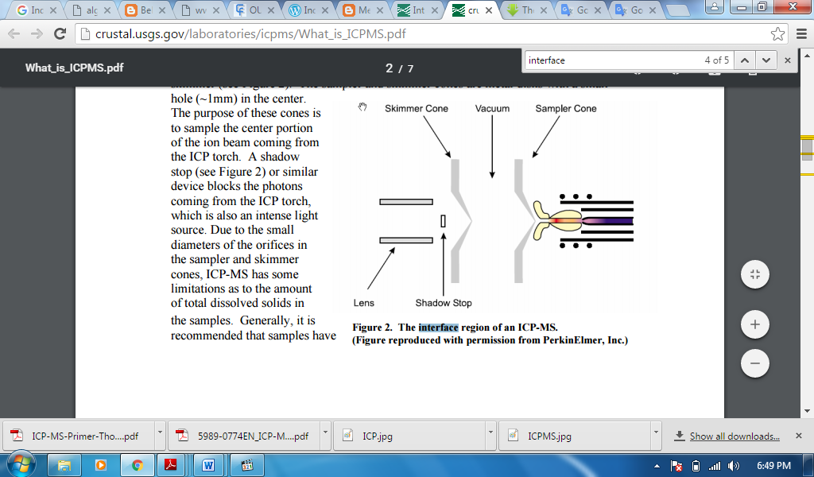
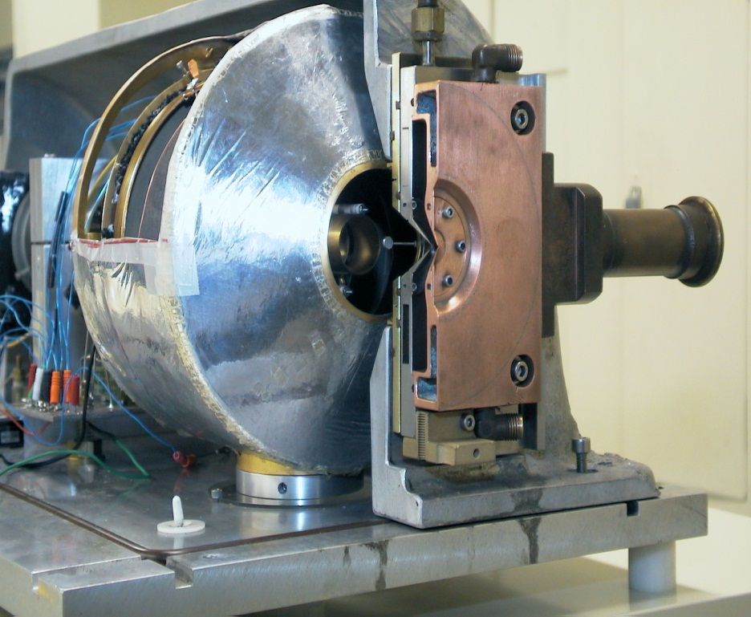
INTERFACE
Interface serves to direct the ions toward the mass spectroscopy.
Interface area consists of two conical metal (usually nickel) called sampler cone and skimmer cone, each with small holes to allow ions to pass through to the ion optics

Slide 19
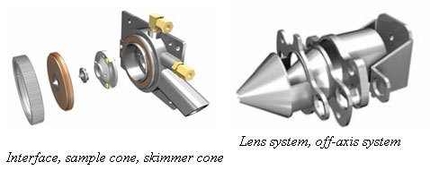
Ion Lenses
Prevent Neutron and photon to enter
Reduce interferences

Slide 20
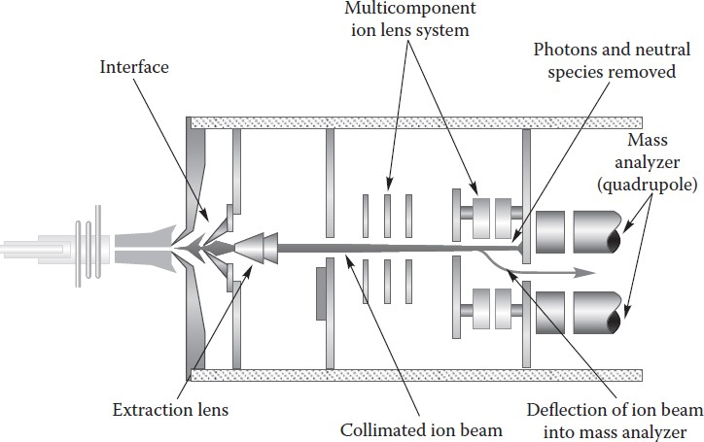
ICP Ion Focussing Region
One or more electrostatically controlled lens component made up of series of metallic plates or cylinders having a voltage placed on them
Ions are separated from Photons & Neutrals by positioning MS off-axis to the ion beam or using a Physical barrier
Role of ion focussing is to transport maximum number of analyte ions
from the hostile environment of plasma to the MS via the interface.
Photons & Neutrals cause signal instability & contribute to
background noise.
Voltages on the ions lens components electrostatically steer the ions of
interest into the MS.

Slide 21
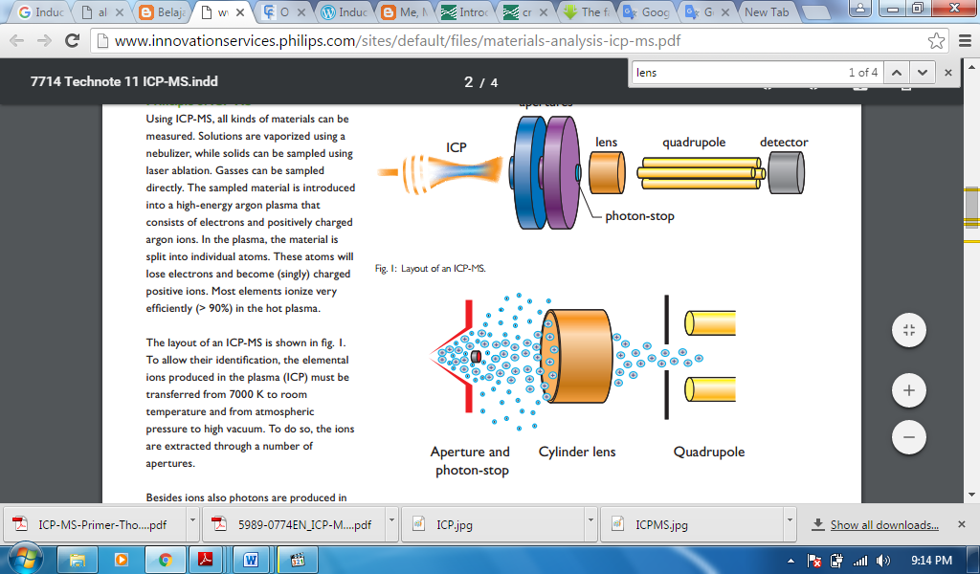
Ion Focusing
Delivers ions toward the Quadrupole
Stop or hinder the electrons, protons and neutrons to the detector analyzer

Slide 22
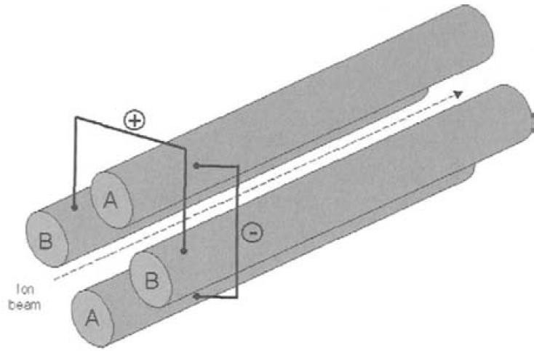
Mass Analyzer- Quadrupole
Made of stainless steel or molybdenum with ceramic coating, 15-25 cm in length, 1cm in diameter
Scanning mode and selective mode
Quadrupole is a sequential mass filter, which separates ions based on their m/z.
Two pairs of parallel cylindrical rods to which a varying AC voltage plus a DC voltage is applied.
Any ion above or below the set mass of the quadrupole enters an unstable trajectory and gets lost from the ion beam.
Measurement of the m/z of the ion allows qualitative identification of the isotope or molecule. Magnitude of the ion current is used to provide quantitation of the amount of the analyte in the original sample

Slide 23
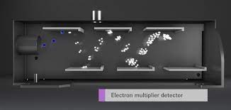
Detector
Electron Multiplier

Slide 24
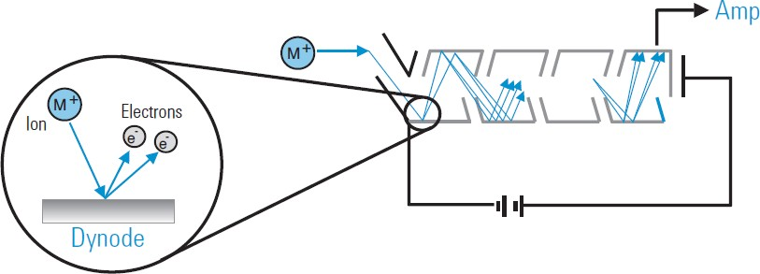
Ion Detectors
Detector is an Electron Multiplier Device which can generate a measurable signal pulse from the impact of a single ion.
A positive ion arrives at the mouth of the detector, it is deflected onto the first dynode, held at a high negative voltage.
The impact of the ion releases several free electrons from the dynode surface, which are repelled from the high negative voltage at the front and strike the next dynode.
Each electron which strikes a dynode releases several electrons from that surface and hence the device is called "electron multiplier". The multiplication factor builds up a pulse large enough to be measured reliably as an ion "count".

Slide 25
Spectral Interferences – I
Probably most serious type of interferences observed in ICP-MS
Polyatomic or molecular spectral interferences: produced by the combination of two or more atomic ions derived from the
Plasma / nebulizer gas (e.g. ⁴⁰Ar⁺ vs ⁴⁰Ca⁺; ⁴⁰Ar¹⁶O⁺ vs ⁵⁶Fe⁺; ⁴⁰Ar⁴⁰Ar⁺ vs ⁸⁰Se⁺; ³⁸Ar¹H⁺ vs ³⁹K⁺; etc.)
Matrix components in the sample (e.g. ⁴⁰Ar²³Na⁺ vs ⁶³Cu⁺; etc. )
Solvent or acid used in the sample preparation (e.g. ⁴⁰Ar¹²C⁺ vs ⁵²Cr⁺; ⁴⁰Ar³⁵Cl⁺ vs ⁷⁵As⁺; ³⁵Cl¹⁶O+ vs ⁵¹V⁺; ⁴⁰Ar¹⁵N⁺ vs ⁵⁵Mn⁺; ³²S¹⁶O¹⁶O⁺ vs ⁶⁴Zn⁺; etc.)
Entrained oxygen and nitrogen from the surrounding air

Slide 26
Spectral Interferences – II
Hydrides, oxides, hydroxides species:
Produced by the combination of elements present in the sample with 1H+, 16O+ or 17OH+ (either from water or air), occur at 1, 16, and 17 mass units respectively higher then the element mass
Typically produced in the cooler zone of the plasma, immediately before the interface region
If rare earth or refractory-type elements are present in the sample, they readily form molecular species (especially oxides)
Doubly charged species:
When an ion is generated with a double positive charge, instead of normal single charge – produces an peak at half of its mass
Doubly charged species formation is influenced by ionization condition in the plasma – secondary discharge at the interface enhances doubly charged species formation

Slide 27
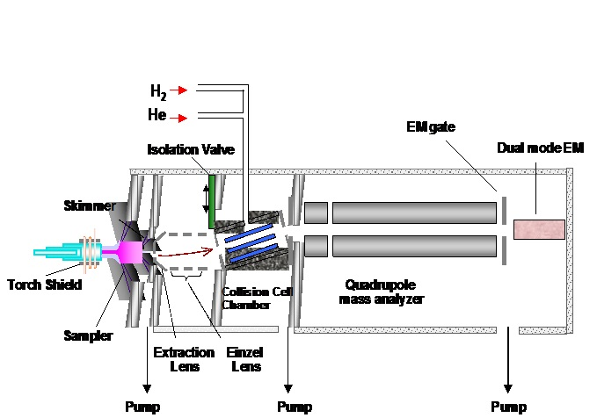
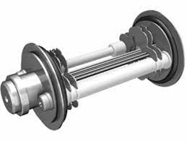
Collision Reaction Cell
Octopole ion guide, positioned between ion lens assembly and quadruple mass filter.
Helps in reduction of spectral interferences.

Slide 28
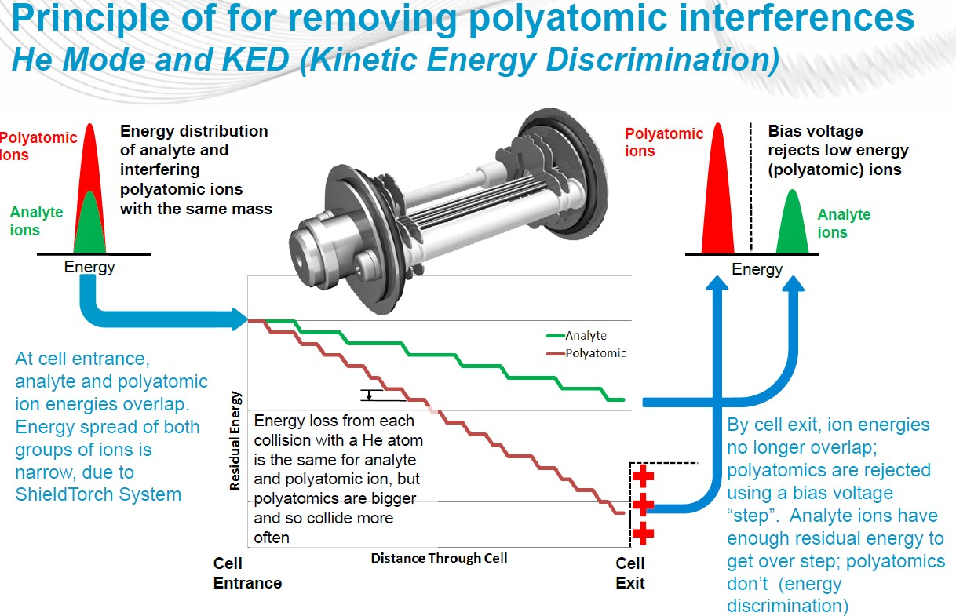
Collision Mode:

Slide 29
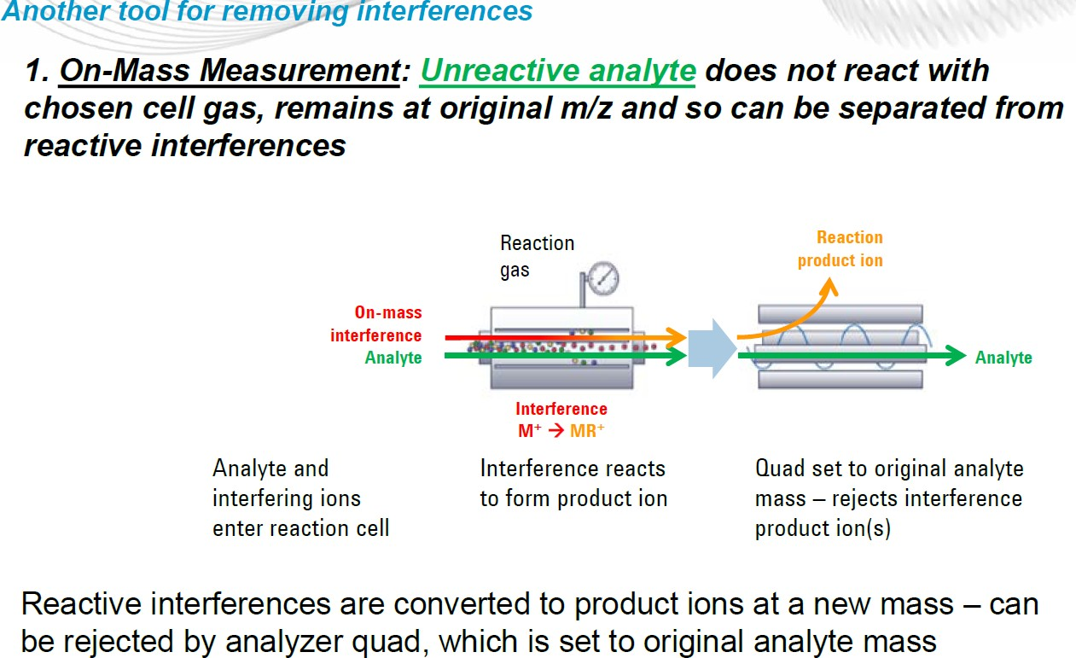
Reaction Mode:
⁴⁰Ar ³⁵Cl⁺ +H₂ → HCl+ Ar⁺

Slide 30
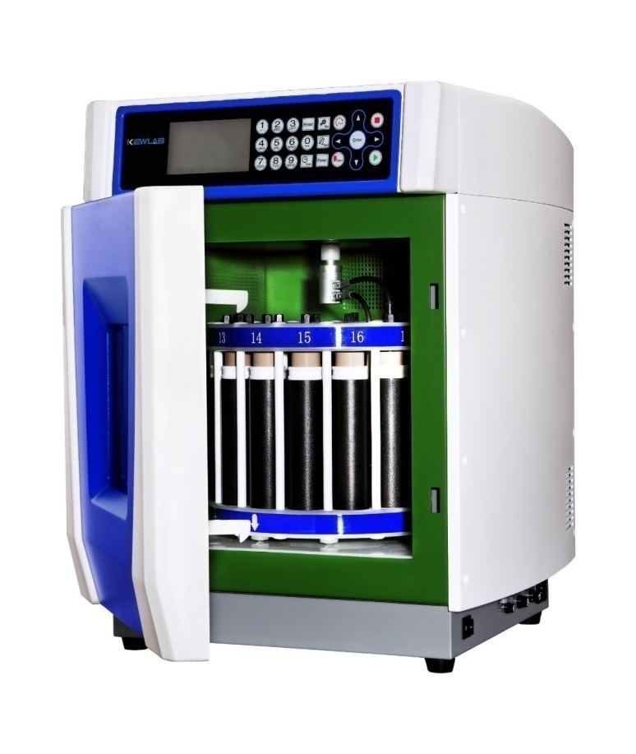
Sample Preparation
Biological/rock samples are usually diluted or thermally digested before analysis.
Common diluents include dilute acids (e.g. nitric acid, hydrochloric acid) or alkali (e.g. ammonium hydroxide, tetramethylammonium hydroxide)
Solid samples such as rocks, tissue, hair and nails require chemical digestion to dissolve the sample before analysis.
The digestion can be carried out using strong acid(s) or alkali, either at room temperature or heated in a hot water bath, dry heating block or high-pressure microwave to assist digestion.

Slide 31
Internal Stadardization
Employed to correct for changes in instrument operating conditions and sample specific matrix effects which may enhance or suppress the analyte signal.
Same quantity of “internal standard” is added to each sample, standard and blank.

Slide 32
Contamination issues
Various factors influence the ability to get the correct result with any trace element technique. Potential Sources of contamination must be addressed

Slide 33
Methods of Quantification
Quantitative analysis in ICP-MS is the fundamental tool used to determine analyte concentrations in unknown samples.
The instrument is calibrated by measuring the intensity for all elements of interest in a number of known calibration standards that represent a range of concentrations likely to be encountered in your unknown samples.
Software creates a calibration curve of the measured intensity versus concentration for each element in the standard solutions
Once calibration data are acquired, the unknown samples are analyzed by plotting the intensity of the elements of interest against the respective calibration curves. The software then calculates the concentrations for the analytes in the unknown samples.
This type of calibration is often called external standardization and is usually used when there is very little difference between the matrix components in the standards and the samples

Slide 34
ICP-MS application
Environmental
Drinking water, ambient water
Soils, Sludge, Solid waste
Plant material/Agriculture
Speciation of Hg, As, Pb and Sn
Clinical
Blood, Urine, Serum
Hairs, Tissues
Toxicology
Nutrition/deficiency/ vitamins
Food analysis
Nutrition
Toxic element and species monitoring
QA/QS
Pharmaceutical
Routine heavy metal contamination
Drug discovery
Clinical trials
Nuclear
Fuel production
Measurement of radioisotopes
Primary cooling water
Geological
Soil, Rock, Sediment
Hydrology
Isotope ratio studies
Archaeological
Artifact analysis, proof of origin
Tooth, bone, tusk, shell, coral analysis
Forensics
Gun shot residue
Material characterization
Point of origin
Poisoning

Slide 35
Role of ICP-MS in pharmaceuticals
Ensures pharmaceutical products : drug safety, efficacy, and compliance with regulatory and safety standards.
Helps manufacturers comply with global regulations on elemental impurities.
Trace Element and Impurity Testing
Trace Element Analysis and Impurity Testing
Toxic Element Detection:
Detects toxic metals: Lead (Pb), Arsenic (As), Cadmium (Cd), Mercury (Hg), etc.
Essential for complying with USP 232 and USP 233 guidelines.
Regulatory limits on metals to ensure safety for patients.
Elemental Impurity Testing:
Quantifies heavy metals and toxic elements to prevent contamination.
Ensures finished drug products meet international standards for impurity levels.

Slide 36
In Pharmaceutical Analysis or Quality Control
Characterization of Raw Materials:
Tests active pharmaceutical ingredients (APIs) and excipients for elemental contamination.
Ensures consistency and purity of materials used in drug formulation.
Finished Drug Product Testing:
Monitors elemental composition of tablets, capsules, injectables, and syrups.
Ensures drug safety, quality, and stability throughout the product lifecycle.
Stability and Shelf-Life Testing:
Measures elemental changes over time to ensure product stability.

Slide 37
Example: Determination of heavy metals in herbal medicines
We wish to thank Hua Zhang, Yan-zhi Shi and Ying-feng Wang at the Capital Normal University in Beijing, China for their permission to publish the results from their scientific study*
Shugan pill exceeds legal limits for Hg (0.2 ppm) and As (2.0 ppm)
[

Slide 38
Metal impurities – Leachables from pharmaceutical packaging materials
Interaction between formulation and packaging material results in components migrating into the drug product
These components may be toxic or affect the stability of the drug product
Storage conditions impact leaching (heat, UV radiation, storage time)
Typical leachables are:
Small organic molecules [monomers, excipients, reaction by-products],
Metal ions and trace elements (e.g. aluminum, cadmium, chromium, copper, lead, manganese, and zinc)
“Metal ions can affect the stability of the formulation, catalyze the degradation of the active pharmaceutical ingredient (API) and cause unqualified degradates to form, or pose a toxicity threat on their own.”
KYLE A. FLlSZAR, DAVID WALKER and LEONARDO ALLAIN, Profiling of Metal Ions Leached from Pharmaceutical Packaging Materials, PDA Journal of Pharmaceutical Science and Technology, Vol. 60, No.6, November-December 2006

Slide 39
What is speciation?
“Elemental Speciation - the analyses that lead to determining the distribution of an element’s particular chemical species in a sample. This may be further associated with oxidation state, organometallic nature or complex form.”*

Slide 40
Why do we need speciation?
Almost all elements form species which can alter their toxicity and mobility
Cr^{III} vs Cr^{VI}; inorganic As vs organic As
Some species vary in toxicity or therapeutic activity
Pt-containing drugs in cancer treatment
Anti-tumour activity versus side effects of drugs and metabolites
Species with different structure and Pt oxidation state
Heavy metal or pesticide impurities in natural products
For example, organomercury or organophosphorus species
Need simple, selective, rapid, sensitive and accurate
determination of these species

Slide 41

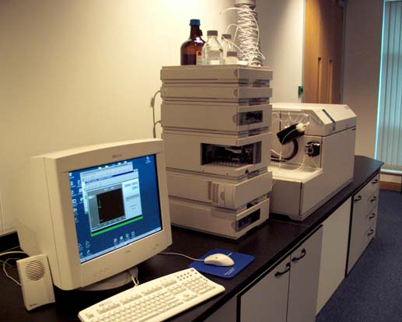
LC-ICP-MS –technique
ICP torch
Q-pole mass filter
nebulizer & spray chamber
turbo molecular pump
turbo
molecular
pump
rotary pump
gas controller
Ar gas

Slide 42
Principles of laser ablation (LA) ICP-MS
Procedure:
Laser beam focused onto sample surface in ablation chamber or cell
Miniature plasma above sample ablates material from surface
Resultant particulate material is transported to ICP-MS with carrier gas stream (e.g. Ar)
Sample is decomposed, atomised and ionized in ICP plasma and analyzed in mass spectrometer
Applications for LA-ICP-MS:
Monitor distribution of administered drugs among different tissues and body compartments
In-situ analysis of metals and other elements in samples separated using PAGE*, e.g.:
Au and Pt drug metabolite identification
*

Slide 43
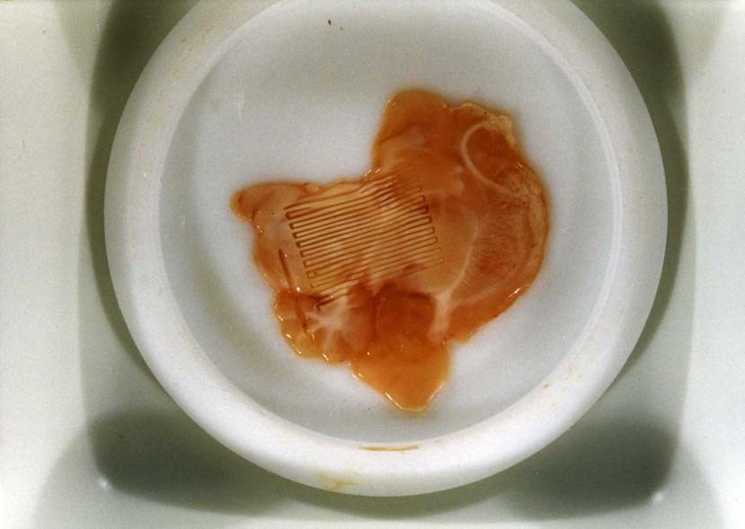
In-situ direct tissue analysis
Example: Analysis of brain tissue (rat)
Brain tissue –
the laser sampling pattern can be seen on the rat brain tissue sample
After administration of the drug, the test animal is freeze-dried, encased in polymer and microtomed. Individual sections are then analyzed using laser ablation.
Courtesy of Centre for Analytical Sciences, Sheffield

Slide 44
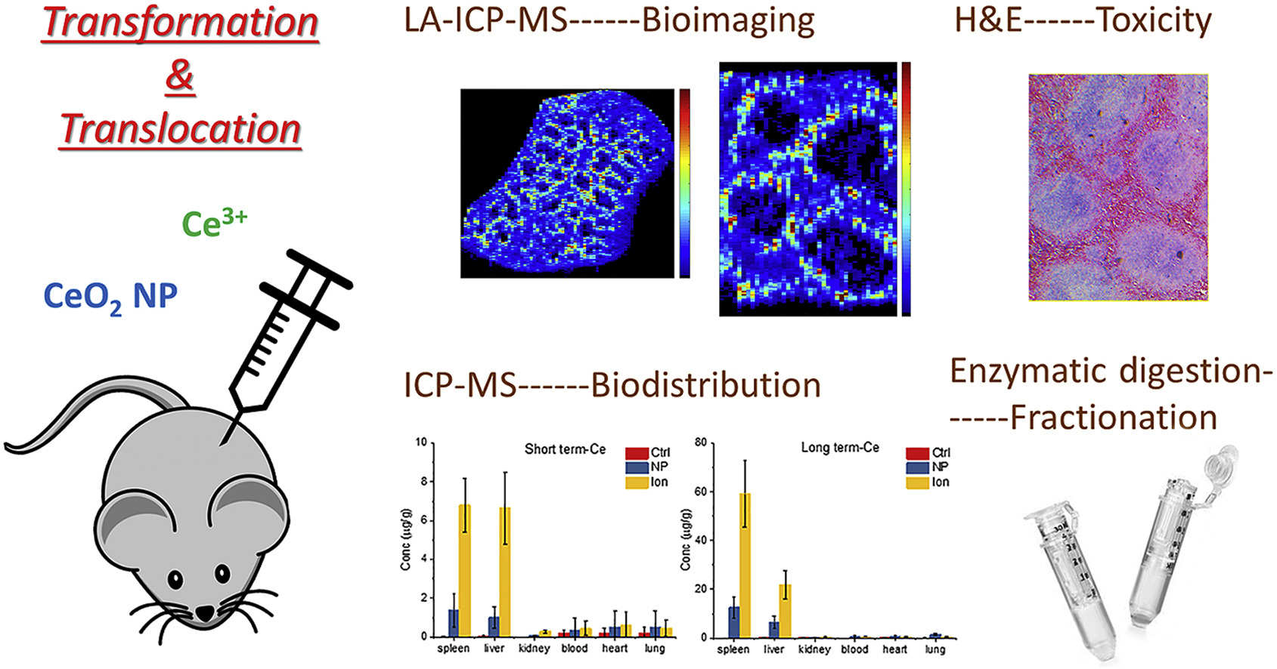
Example: Element distribution in rat
Chen et al., 2019

Slide 45
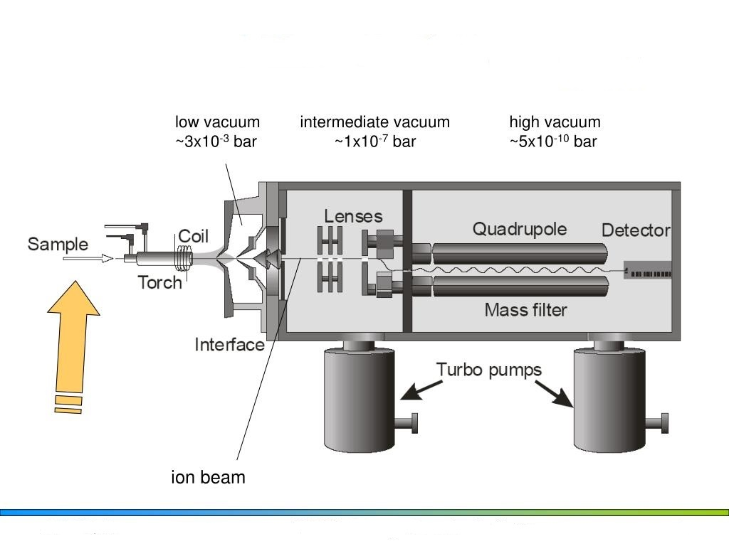
Key take away

Slide 46
Pharmaceutical Export Compliance: Pharmaceutical Quality Control
High Sensitivity: Detects trace and ultra-trace levels of elements, essential for compliance with stringent regulations.
Multi-element Analysis: Simultaneously analyzes multiple elements in one test, saving time and increasing efficiency.
Rapid and Accurate Results: Delivers quick, precise measurements crucial for maintaining product quality and meeting regulatory timelines.
Global Regulatory Compliance: Ensures drugs meet safety and quality standards set by organizations like FDA, EMA, and WHO.

Slide 47
Thank you

Slide 48
Safety Guidelines
Daily
Check Argon level and pressure, inspect peristaltic pump tubing & drain (connections OK, no filling of spray chamber or connector) and visual inspection of sample cone exterior. Don’t use any kind of glass ware during sample preparation.
Typical Argon gas pressure range on Gas panel is 6-7kg/cm2(<7kg/cm2) with 20L/min flow and for cell Gas I.e. Helium pressure on Gas Panel is 1-1.5kg/cm2.
Always set the following pressure on Dual stage regulator line pressure to 8kg/cms2 for Argon and for Helium 2kg/cm2.
Purge the system with Argon gas for 10 min daily before start-up
Purge the system with Helium gas for 20 min daily before start-up

Slide 49
Check the Peristaltic Pump tubing, replace if required
After Plasma ignition wait for 20-30 min to stabilize the plasma
Start the Chiller 5 min. before plasma ignition
Exhaust should be on continuously (24hrs x 7days)
Vacuum should be on continuously i.e. system should be in standby mode always.
Maintain Room Temperature between 15-30 °C, < 2 °C/h change and total change should be < 5 °C & Humidity 20-80 %.
Room atmosphere should be Non Condensing and Non Corrosive. Frequently, as needed
Empty the drain reservoirs, thorough visual inspection of both cones, check nebulization, replace peristaltic pump tubing, clean torch, check recirculation water level.

Slide 50
Weekly
• Re-prepare or re-dispense tuning solutions and rinses.
• Observe Torch, Connector, bonnet, Spray chamber, Nebulizer, Sample Cone & skimmer cones. Clean if it is contaminated, this cleaning depends on Usage of System

Slide 51
Monthly
• Check rotary pump oil level, check oil mist filter condition, check extraction lens and clean if discolored.
Every 6 months
• Check extraction and off-axis lenses, change rotary pump oil, check/replace gas tubing, check/replace pump mist filter.
• Replace Sample & Skimmer cones if deteriorated Infrequently performed, but important to perform (as indicated)

